Slide 1

Phishing Attacks: Recognize and Avoid Scams
Stay Safe Online
Presented by GUJJALA CHARAN | 28-04-2025

Slide 2
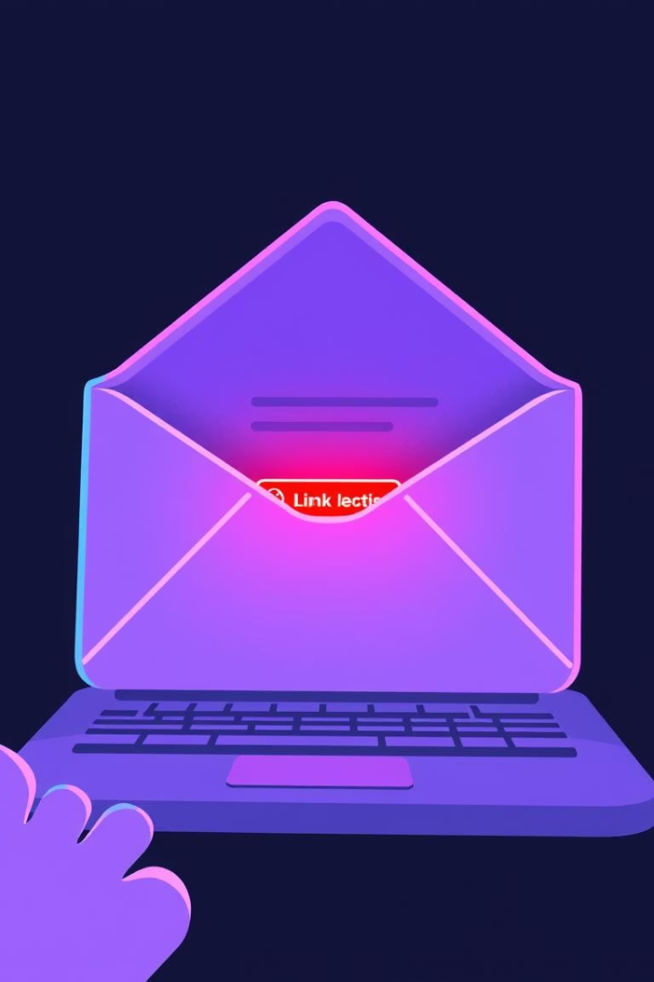
What is Phishing?
Definition
Phishing is a cyberattack to steal sensitive data like passwords and credit cards.
Goal
Attackers deceive to gain unauthorized access and personal information.

Slide 3
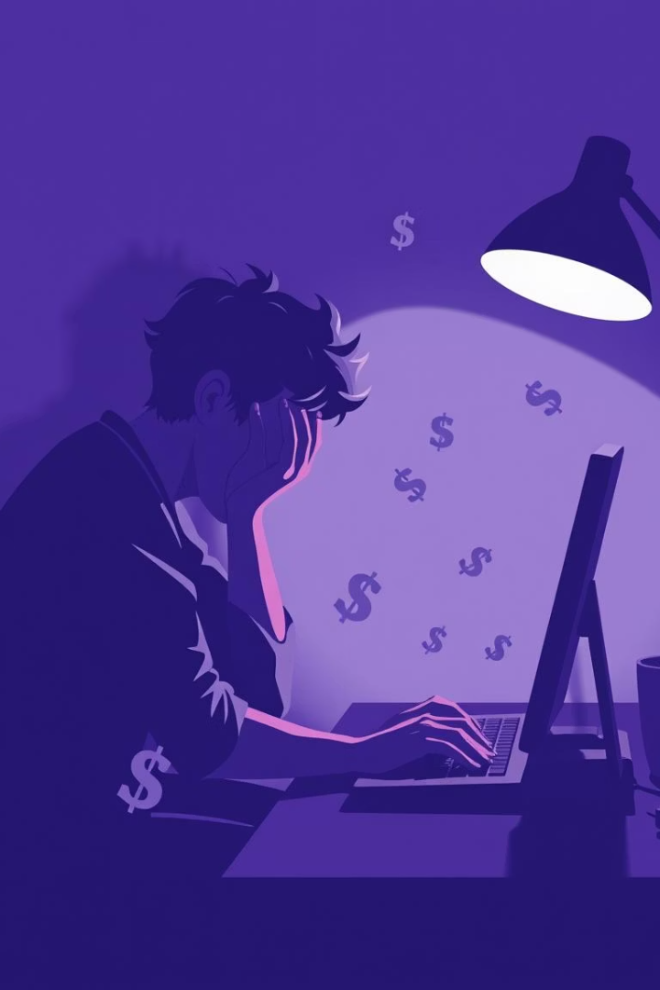

Why is Phishing Dangerous?
Financial Loss
Identity Theft
Phishing can drain bank accounts and cause monetary damage.
Stolen identity leads to fraud and personal reputation harm.
Data Breaches
Company and personal data exposure with major privacy risks.

Slide 4



How Phishing Works
Social Engineering
2
Manipulates emotions like fear and urgency to prompt action.
Deceptive Emails
1
Fake emails mimic trusted sources to trick victims.
Urgency Tactics
Threats or deadlines pressure victims to react quickly.
3

Slide 5
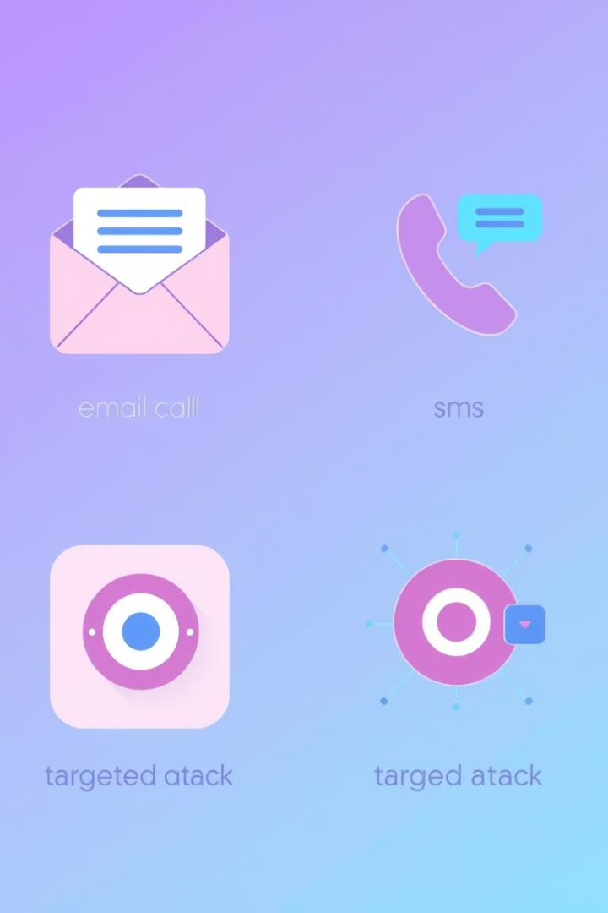




Common Types of Phishing
Email Phishing
Spear Phishing
Vishing
Mass emails targeting many users with fraudulent messages.
Highly-targeted attacks on specific individuals or organizations.
Phone calls pretending to be trusted agents to extract info.
Smishing
Text messages tricking recipients into clicking fake links.

Slide 6
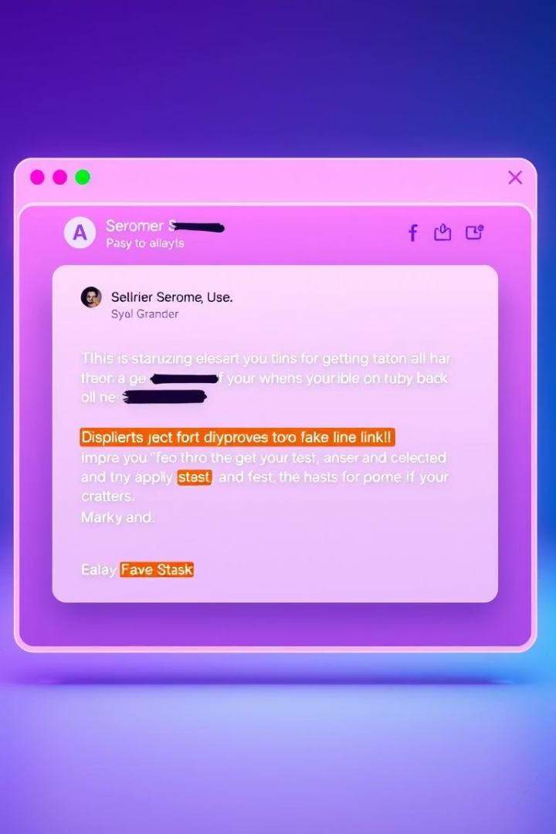
Anatomy of a Phishing Email
1
Suspicious Sender
From unknown or spoofed email addresses.
2
Urgent Language
Pressures to act immediately or face consequences.
3
Fake Links
URLs that look legitimate but lead to dangerous sites.
4
Unusual Attachments
Files potentially containing malware or ransomware.

Slide 7
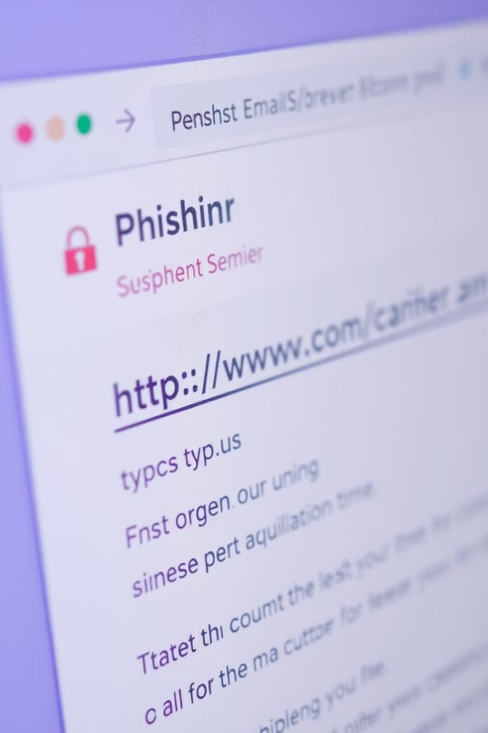
Visual Example: Phishing Email
Suspicious Sender
Fake URL
Address doesn't match expected contact.
Hover reveals link differs from displayed text.
Poor Grammar
Multiple spelling errors and awkward phrasing.

Slide 8
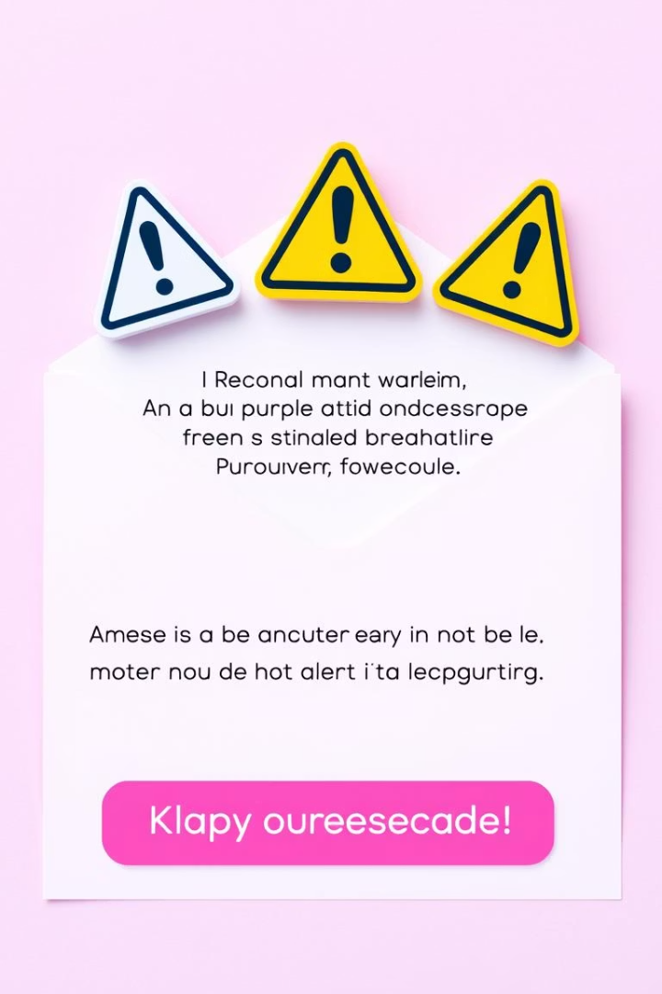
Red Flags in Phishing Emails
Poor Spelling & Grammar
Errors and awkward language hint at fraud.
Unusual Sender Address
Mismatch between the sender and claimed source.
Generic Greetings
Impersonal salutations like "Dear user"
Requests for Info
Legitimate companies rarely ask for passwords or credit cards.

Slide 9
Phishing Websites
Look-Alike URLs
Fake Login Pages
Unsecure Sites
Slight misspellings or added words in site addresses.
Copied designs trick users into entering credentials.
Missing HTTPS or padlock in browser address bar.

Slide 10
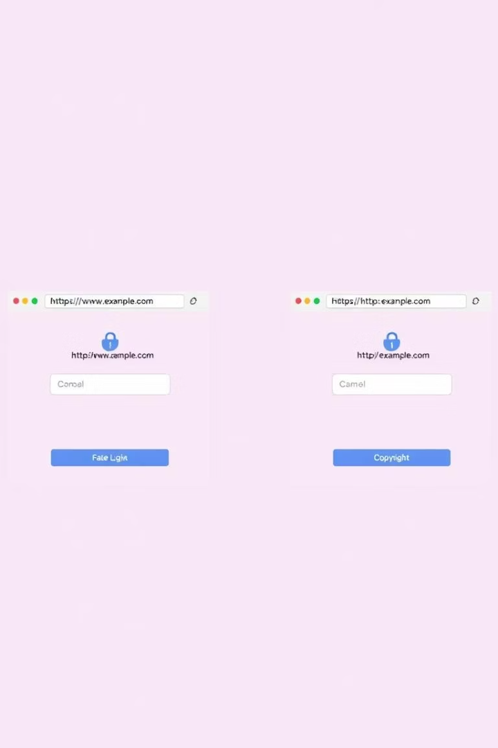
Visual Example: Fake Website
Differences in URL
The fake site uses misspelled or suspicious URLs.
Design Flaws
Slight inconsistencies in color, logo, or layout.

Slide 11
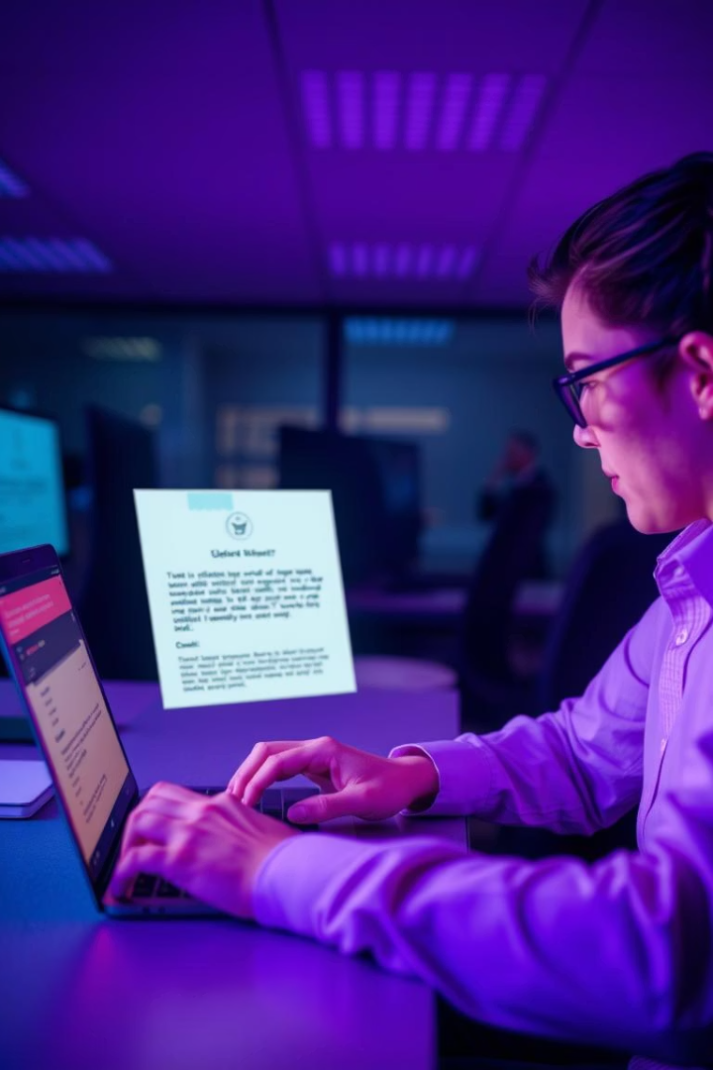
Understanding Phishing Attacks
Learn to recognize and avoid phishing emails, websites, and social engineering tactics. Stay safe and protect your data and identity from cyber threats.
CG
by Charan Gujjala

Slide 12

Social Engineering in Phishing
Emotional Manipulation
Impersonation
Phishers use fear, greed, and curiosity to trick victims.
Attackers pretend to be bosses or banks to gain trust.

Slide 13
Smishing and Vishing
Smishing
Vishing
Example Scenarios
Phishing attack via SMS texts to steal data or deliver malware.
Voice call phishing to trick victims into revealing sensitive info.
Fake bank alert SMS requesting personal info
Caller posing as IT support asking for passwords

Slide 14

Real-World Phishing Examples
2020 Twitter Hack
Google & Facebook Scam
Attackers gained access to high-profile accounts via social engineering.
$100 million lost after employees were targeted with phishing emails.

Slide 15





Consequences of Phishing
Financial Fraud
Identity Theft
Data Loss
Loss of money through unauthorized transactions
Personal info used for fraud and illegal activities
Company secrets and client data compromised
Reputation Damage
Loss of trust from customers and partners

Slide 16
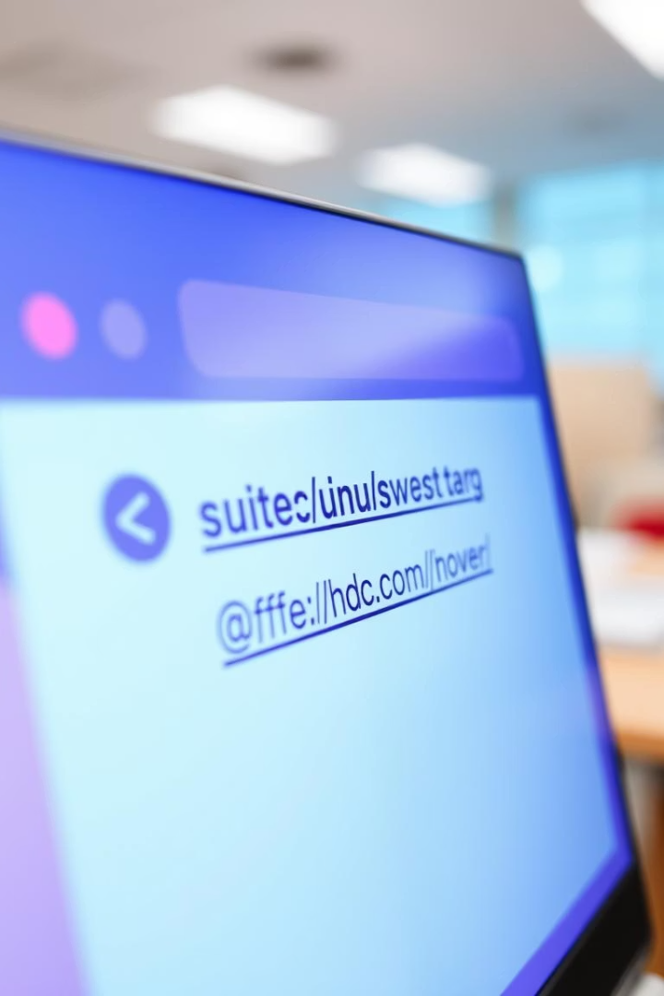
How to Recognize Phishing Attempts
Check Sender’s Email
Look for slight misspellings or unusual domains
Hover Over Links
Reveal URLs before clicking to see real website
Verify Requests
Confirm via phone or official channels before acting
Use Official Websites
Manually type URLs instead of clicking links

Slide 17
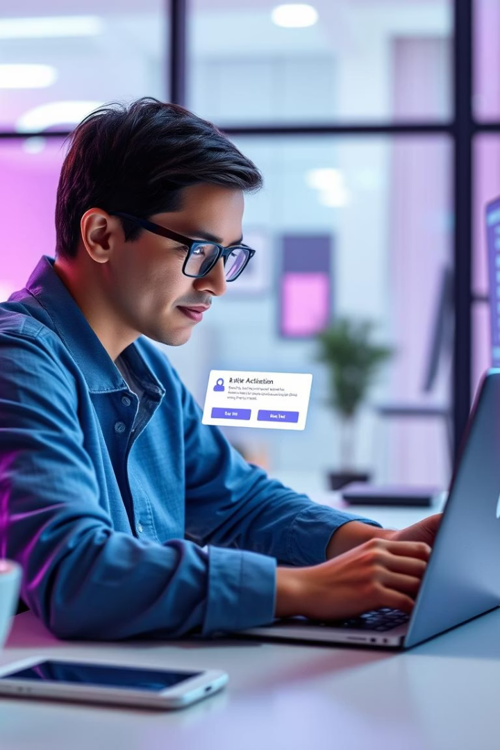
How to Avoid Falling for Phishing
Don’t Click Suspicious Links
Be cautious with unexpected emails or messages
Protect Your Info
Never share passwords or sensitive data via email
Use Two-Factor Authentication
Add extra security layer on accounts
Keep Software Updated
Patch vulnerabilities that attackers exploit

Slide 18
Tools to Combat Phishing
Email Filters
Anti-Phishing Plugins
Security Training
Automatically block known phishing messages
Browser tools that warn about dangerous sites
Educate employees to spot and report phishing

Slide 19





What To Do If You Suspect Phishing
Do Not Interact
Avoid clicking or replying to suspicious messages
Report Immediately
Notify your IT or security team for action
Change Passwords
Update credentials to prevent account compromise
Monitor Accounts
Watch for unusual activity or unauthorized access

Slide 20

Key Takeaways & Thank You
Stay Cautious
Verify Requests
Be wary of unexpected emails and messages
Double-check before trusting any communication
Continuous Learning
Keep updated on phishing tactics and defenses
Questions? Reach out anytime to learn more. Stay safe!

